Slide 1


Microcontact:
How to take synchrony, diachrony, and sociolinguistics into account when studying variation
Roberta D’Alessandro
UiL-OTS, Utrecht University
Transdisciplinary Approaches to Language Variation
Tromsø, April 19, 2018

Slide 2
Syntactic change
From an internalist perspective: once a grammar is acquired it will not change.
Phonology and morphology can change, but syntax should not.
There is no way to move from E-language to I-language once the I-language is fixed (Chomsky 1957 ff).
Longobardi’s recent work: syntactic change always happens together with some other change, be it phonological, morphological or semantic (inertia) (originally proposed by Keenan 2002, Longobardi 2001).
(but Owens 1996: first syntax changes, then we see the reflex in morphology; see also Reintges)

Slide 3
From E-language to I-language
Different perspective within GG: Change is “a set of differences between two grammars” (Hale 1998:2-3).
These perspectives are less straightforward on a model of syntax that places much if not all variation at the PF interface (see i.a. Berwick & Chomsky 2011).
Grammar stays the same: interface conditions change.
Changes get internalized by the next generation
(this is true both for monolingual L1 acquisition and for heritage language acquisition)

Slide 4
Two kinds of language change: EC and CIC
Two kinds of language change:
Endogenous change (EC)
Change-in-contact (CIC)
Are CIC and EC underlyingly the same mechanism?
Is there some sort of generalized tendency towards simplification / less markedness?

Slide 5
EC
Language change (change in diachrony) scholars have mostly been preoccupied with:
    the directionality of change (Kiparsky 1968, Hopper 1990, 1991, Keller 1994, and more recently Newmeyer 1998, Campbell 2001, Traugott 2001, Haspelmath 1999, 2004 and many others)
    the causes and mechanisms of change (Roberts & Roussou 2003, Roberts 2007, Roeper 1993ff, Lightfoot 1991, Kroch 1994, Lightfoot & Westergaard 2007, Westergaard 2008l 2011 …)

Slide 6
EC / The grammaticalization path
  “Path” of change (from one grammar to another),
  In generative terms: XPs become heads higher in the structure (Roberts 1997, Roberts & Roussou, 2003, Van Gelderen 2004)
  parameter resetting along a hierarchy
  From lexical to functional; from more marked to less marked; from more features to fewer features
  Competing grammars or optionality within one grammar
Keyword: simplification
Language acquisition; change is the result of some sort of reanalysis by the language learners (the more cues or micro-cues are shaded the more likely change will take up)
Adults can’t change the language (according to most GG)

Slide 7
EC / The grammaticalization path
In typological terms: universals of language change, often called grammaticalization paths (Lehman 1993, Hopper & Traugott 1993, Haspelmath 1999).
Traditional historical studies all postulate some sort of direction for language change (Meillet 1912 ff).
Keyword: ~ simplification

Slide 8
CIC (typological perspective)
A totally different story
Socio-historical factors are much more relevant
“Converging languages in an area are likely to adopt new patterns from multiple sources, or acquire new shared grammatical structures, creating a “compromise pattern”. Alternatively, one language may adopt the grammar of another.
Balanced language contact, without one language trying to oust the other, goes together with long-standing multilingualism and promotes contact-induced increase in language complexity.
The opposite (‘displacive’ language contact) promotes language loss and tends to diminish diversity.” (Aikhenvald & Dixon 2006: 48-49)

Slide 9
Three scenarios for CIC
All languages adopt new patterns without losing the old ones
Konkani (India, Indoaryan) has adopted IE type relative clauses, together with Dravidian-type relative clauses; both are now used, in different circumstances
Languages in contact acquire a new common grammar
Balkan Sprachbund (no infinitive, enclitic determiners, …)
One language adopts the grammar of another
Brings to language attrition and obsolence

Slide 10
CIC
Facilitating factors that have to do with grammar:
Pragmatic salience
Tendency to achieve word-for-word intertranslatability
Frequency
Existence of perceivabe gap
Typological naturalness
Pre-existing structural similarity
Existence of lookalike
…

Slide 11
CIC
Facilitating factors that have nothing to do with grammar:
Degree of knowledge of each other’s languages (‘lingualism’)
Kinds of contact
Language attitudes
Balanced and displacive contact
Incomplete language acquisition
Polyglossia
…

Slide 12
CIC (generative perspective)
Heritage languages
L2 acquisition
Incomplete acquisition
L1 attrition
Competing Grammars vs principled variation within one grammar
(you know EVERYTHING about this here!)

Slide 13
EC vs CiC
EC: path
CiC: everything goes
Is it really like that?
How can we tell apart EC from CiC? Most of the times it is impossible

Slide 14
EC vs CIC
Ideally we would need:
Two, three, or more (marked) phenomena
Observable in diachrony (attested for several centuries)
In contact with similar phenomena, within grammars that are exactly the same BUT for the phenomena we are checking
Grammars that come to contact at the same time, in very similar socio-linguistic and historical conditions

Slide 15
EC vs CIC
Grammars: A, B, C, D, E
Identical (in the same domain) but for one element X
Grammar B
Feature X in grammar A in contact with Grammar C
Grammar D AND Grammar E
Feature X in grammar A in isolation

Slide 16


Slide 17
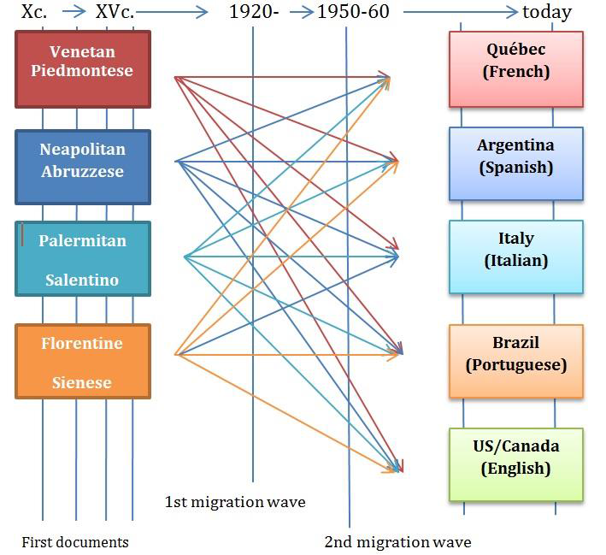
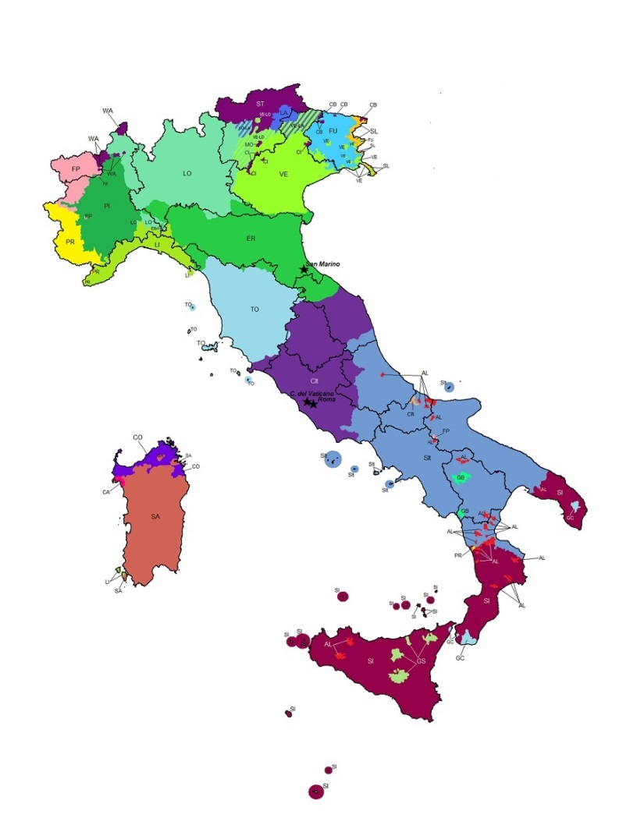
Microcontact

Slide 18
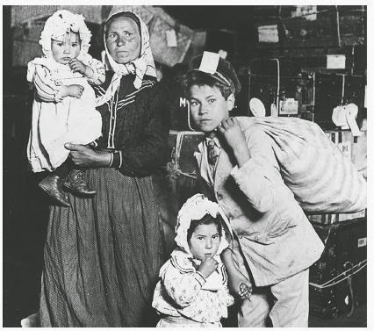
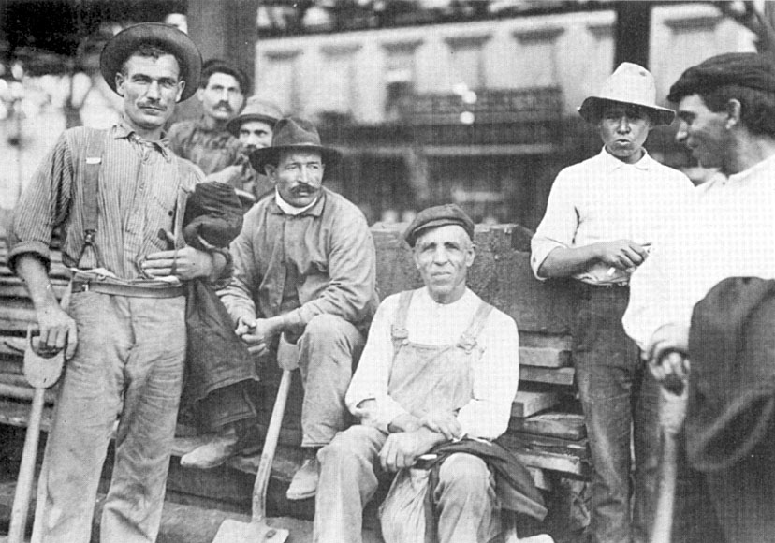
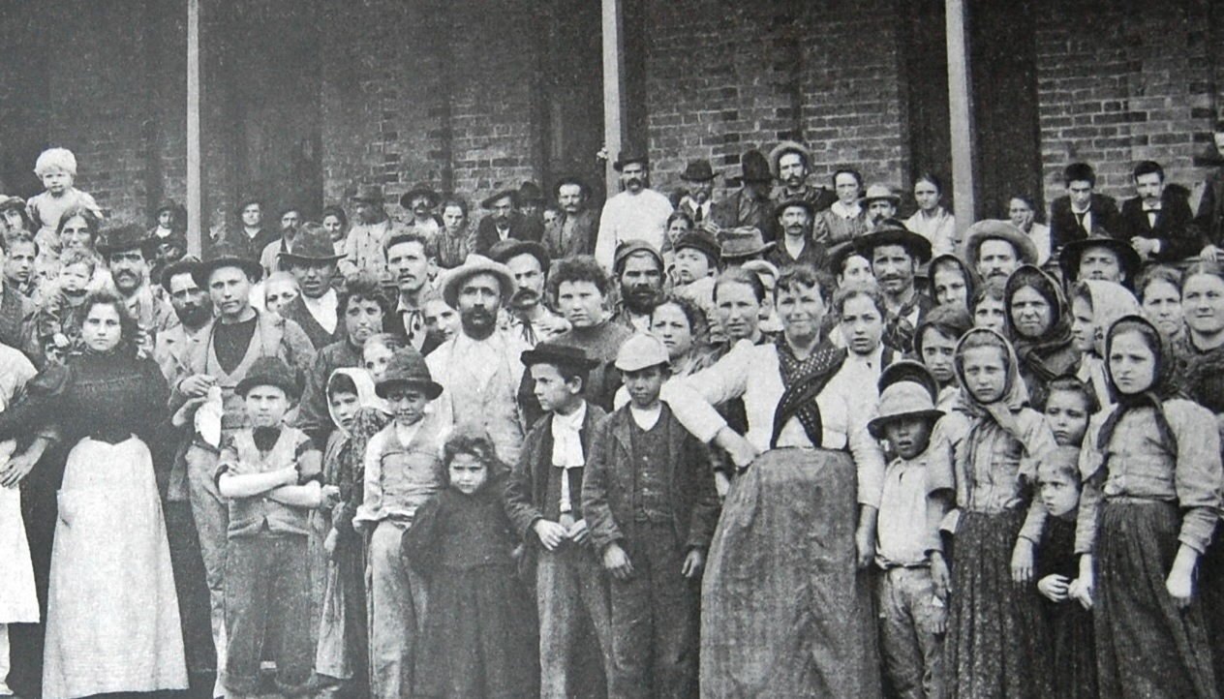
Italian emigrants

Slide 19
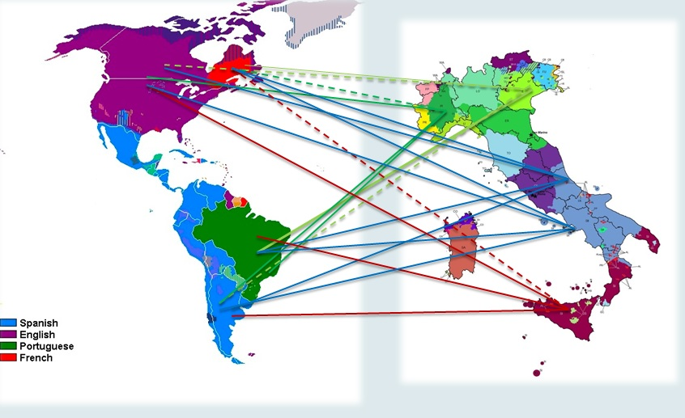
Observing change in contact
The socio-historical conditions in which the languages came in contact are practically identical; we can factor out most extra-linguistic causes
We can still observe optional structures in 1st generation emigrants

Slide 20
Zooming in on change
‘In order to gain a deeper insight into the actual triggering of the borrowing process, we need to zoom in on the initiation phase itself’
(Matras 2011:225)
Look at optional structures: points of choice
Structure 1
clause
Structure 2

Slide 21


Peppino’s grammars
Auxiliary selection or not?
Many choices: Spanish vs Neapolitan
Differential Object Marking or not?
We can only see these optionality points through a microvariational approach

Slide 22
What we expect
Optionality is where change begins
Endogenous change (spontaneous): the structure will become slightly less or more specific, slightly less or more marked (grammaticalization) probably as a consequence of neutralization)
EC will proceed along a hierarchy of markedness >> later
Contact-Induced-Change: the structure will (be able to) change more radically
    CIC will be more random

Slide 23
Optionality
Syntactic doublets
Kroch (1994): syntactic doublets should be categorically excluded from stable grammars, although they can be attested in systems that can be viewed as unstable for one reason or another (e.g. developing and interlanguage systems, dying varieties and those undergoing change more generally).
These doublets are exactly those that we will investigate, in order to observe change in progress. Optionality will hence refer to syntactic doublets in systems undergoing change, be it EC or CIC.

Slide 24
Parameter hierarchy
For a given value v of a parametrically variant feature F:
a. Macroparameters: all heads of the relevant type share vi
b. Mesoparameters: all functional heads of a given category (e.g. all verbal heads, all nominal heads, all φ-bearing heads or all finite Cs) share v
c. Microparameters: a small subclass of functional heads (e.g.
auxiliaries, pronouns) share v
d. Nanoparameters: one or more idiosyncratic lexical items are
specified for v
Biberauer & Roberts (2012)

Slide 25
Hypothesis: Contact forces reopening of parameters
Following Kiparsky (2008): change is constrained by UG.
Hypothesis: UG permits reopening of a parameter, re-setting of a parametric value (at any level), under specific conditions
When contact forces the reopening of a parameter, this brings about the possible co-existence of many equivalent (optional) structures.
The speaker must set the parameter again, hence CIC must happen within one generation, because parameters should not be unset. In exceptional cases, the parameter value can be left open, and this optionality can be resolved by the next generation speakers.

Slide 26
Attrition
L1 attrition is one way to create optional structures
Heritage speakers will “interpret” this optionality and build one or more new (possibly simplified) systems (see Polinsky 1997, 2006; Lohdal & Westergaard 2016).
Is phono-morphological/semantic attrition indispensable for syntactic change (in heritage environments)?
Tsimpli et al 2004 on pro-drop: “semantic features are vulnerable in language attrition whereas syntactic options remain intact.”

Slide 27
Hypothesis: EC
EC will follow a path from more marked to less marked, or from less marked to more marked, one step at a time, along a hierarchy.
Our hypothesis is that EC will only allow one featural specification to move up or down the hierarchy. For very marked structures (which in terms of parameter hierarchy means they are at the very bottom), this means that EG will very likely target them only for simplification. They will thus possibly lose their markedness but only one step at a time.

Slide 28
What microcontact can tell us
1. whether EC and CIC are the same thing
2. what’s the nature of a phenomenon
3. whether there are some syntactic features that are more prone to borrowing than others

Slide 29






Empirical phenomena
“Marked” structures
Doubling structures (repeating the same bit of info twice or three times is more marked that having it only once)
Empirical phenomena:
    Split auxiliary selection Diachrony:
    Differential object marking
    Deixis Theory/synchrony:
    Subject clitics

Slide 30


Microcontact

Slide 31
Subject clitics
(6) Ti te magni [Venetan]
you-2sg SCL-2.sg eat-2.sg
“You eat.”
(7) la drom-la? [Oviglio, Piedmont]
SCL-3.sg.f sleeps SCL-3.sg.f
“Does she sleep?” (Manzini & Savoia 2007:36)
31

Slide 32
Person-oriented auxiliaries
Upper southern auxiliary selection patterns
(8)
a. so magnatə be am eaten.sg ‘I have eaten’ | d. seme magnitə be are eaten.pl ‘We have eaten’
b. si magnatə be are eaten.sg ‘You have eaten’ | e. sete magnitə be are eaten.pl ‘You have eaten’
c. a magnatə have has eaten.sg ‘S/he has eaten’ | f. a magnitə have have eaten.pl ‘They have eaten’
(D’Alessandro & Roberts 2010, D’Alessandro & Ledgeway 2010)
32

Slide 33
In both cases
Extra agreement/Subject doubling
(My analysis: SCL and aux roots are the same thing, D’Alessandro (2017))
i (1/2) mangi [Friulian] So = s (BE=1/2) + -o (1.sg)
i (1/2) t mangis si = s (BE =1/2) + - i (2.sg)
a (3) l mangia a = a (HAVE =3) + a (3)
i (1/2) mangin semə = s (BE =1/2) + -emə (1.pl)
i (1/2) mangé setə = s (BE =1/2) + -etə (2.pl)
a (3) mangin a = a (HAVE =3) + a (3)
33

Slide 34
Auxiliaries and clitics in contact
In Italy:
Auxiliary selection is being replaced by HAVE (HAVE is expanding)
SCLs are disappearing in contact
In Brazil:
SCLs are being created

Slide 35
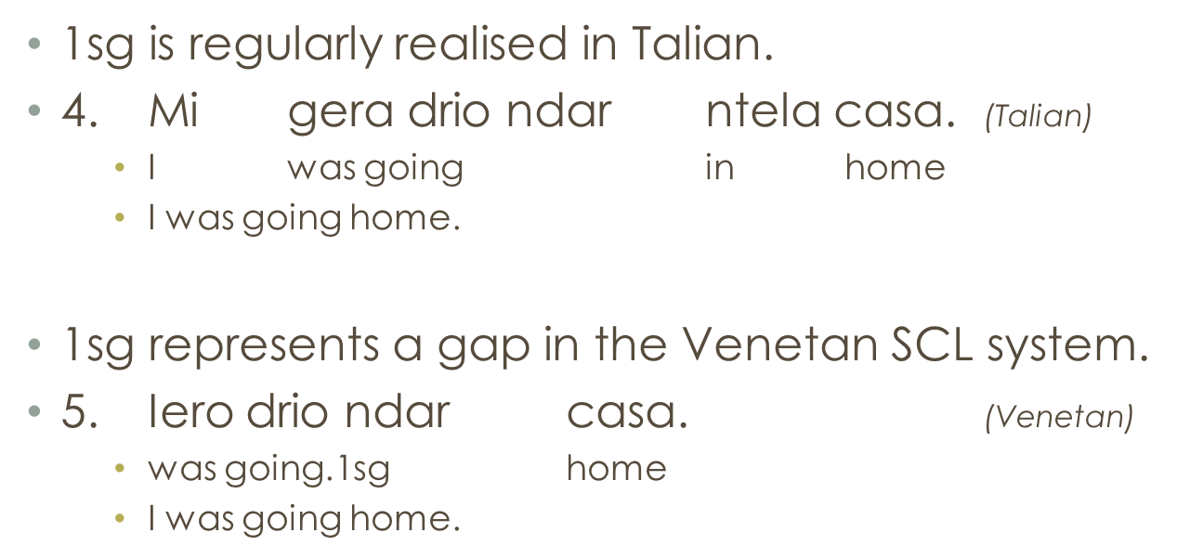
What we have so far (very little)
Venetan (Talian) in Brazil:
Frasson (2018)

Slide 36
Auxiliaries and clitics in contact
Q: are auxiliary roots and SCL really the same syntactic item?
If this were the case, they should behave in the same way wrt to feature loss/change

Slide 37
SCLs and auxiliaries in contact
Are SCLs disappearing in contact varieties?
    It seems so for Veneto in contact with Italian (Casalicchio & Frasson 2018),
    But not in Veneto in contact with BP, where SCLs are being created

Slide 38
What we expect
    What we expect:
    SCLs in contact with Spanish should behave like SCLs in contact with Italian;
    SCLs in contact with French should behave like SCLs in contact with BP
Piedmontese also has SCLs. Will it behave like Veneto?
If CIC is a unitarian phenomenon, it should.

Slide 39
SCLs and auxiliaries
Do SCLs behave the same as auxiliaries wrt features?
Have (marking the absence of person) is expanding in Abruzzese starting from the 1st person singular
- MI is 1st person singular

Slide 40
Three ways of looking at the results
No conclusive evidence.
BE 1st person is disappearing (while Brazilian SCLs are appearing in 1st sg)
But these are completely opposite (person is emerging in one case and disappearing in the other)!
Yes but 1st person is the target in both cases…
> We need more data. We need to see what happens to SCL and AUX in contact with other languages.

Slide 41
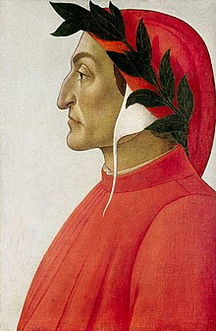

Data collection
(And now begin the dolesome notes to grow
Audible unto me; now am I come
There where much lamentation strikes upon me.)
Dante, Inferno V, 25-27

Slide 42

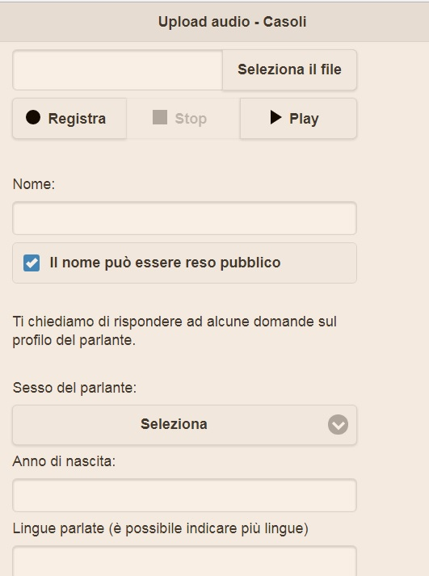
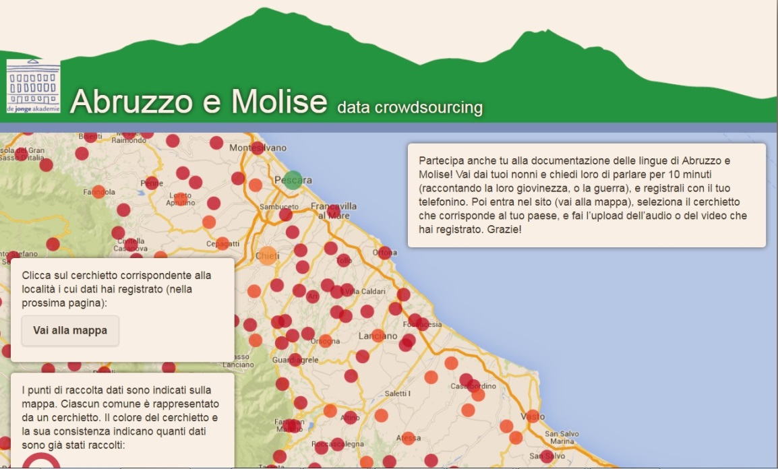
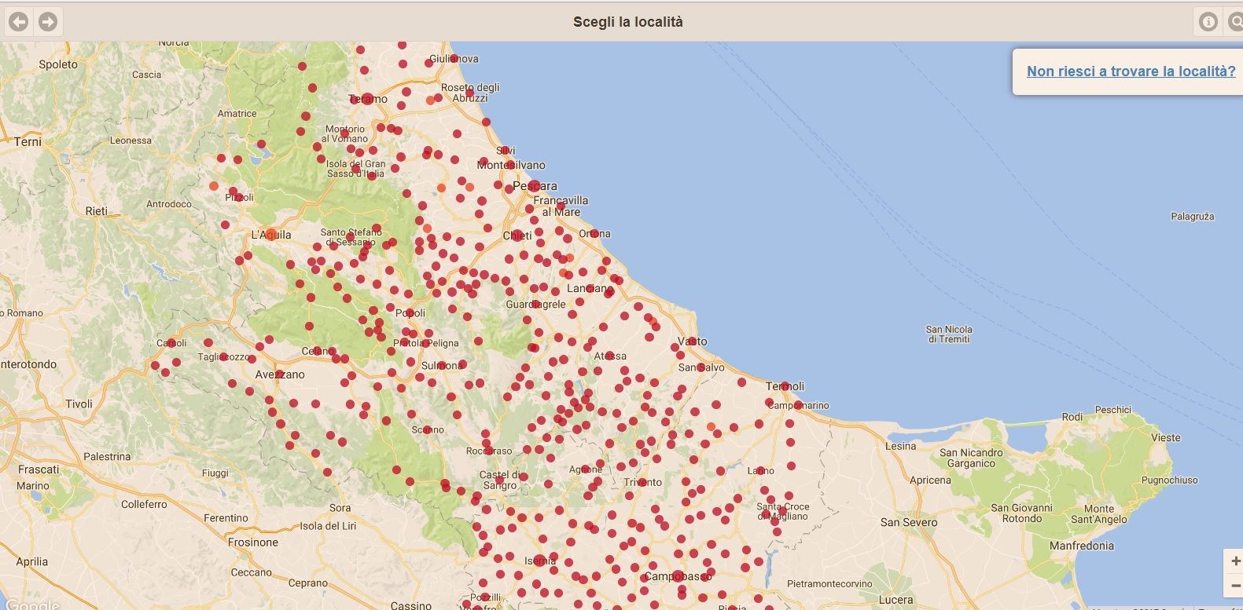
Crowdsourcing

Slide 43
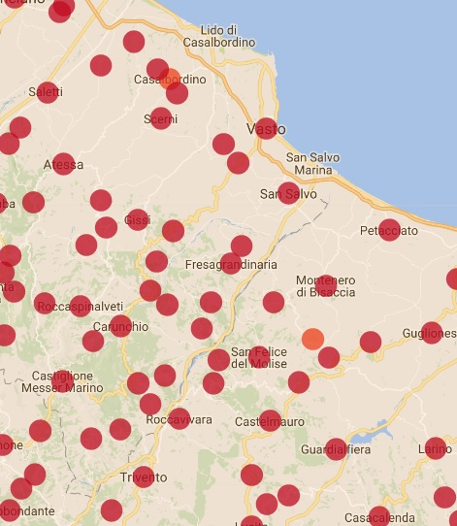
What we got
Video >
Audio >

Slide 44


What we also got
People faking the dialect
People sending poems and all sorts of recordings
People shouting for help
User-friendly website? Users have difficulty with concepts like «Upload», and even to follow simple instructions like «audio not video» or «max 5 minutes»
This was a very «amateurish» pilot
Then I got a grant

Slide 45
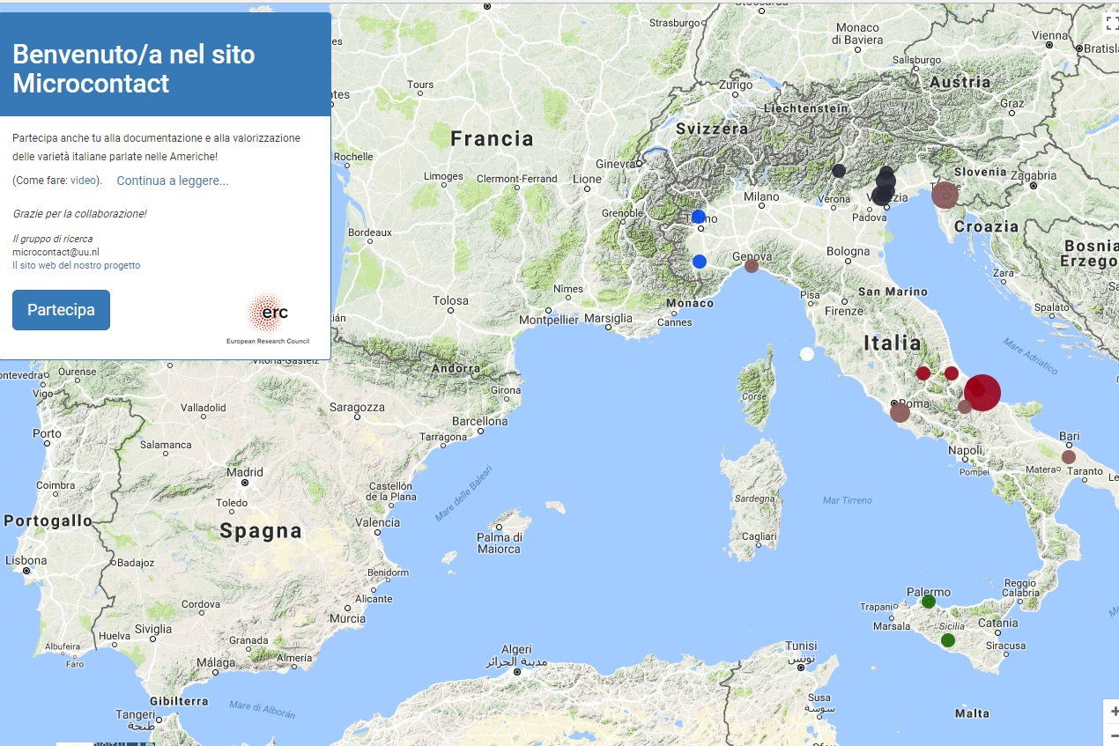

Atlas for data crowdsourcing
https://microcontact.hum.uu.nl

Slide 46
Main issues
GDPR
Getting people to respond
Understanding what they’re saying
Make sure they’re not faking
Make sure they respect their own privacy
Get non-EU countries to declare that they are in conformity with the GDPR…

Slide 47
Good luck to us
and
Thank you!

