Slide 1
When imperfections are perfect: Narrow Syntax from the point of view of Italian varieties
Roberta D’Alessandro
r.dalessandro@hum.leidenuniv.nl
Going Romance 28
Lisbon, 4-6 December 2014

Slide 2
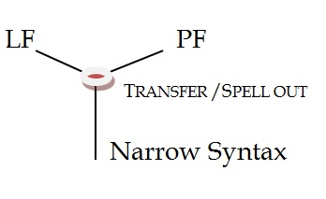
The architecture of language
How is grammar organized?
How do modules interact?
What are the “legibility conditions”?
clitics
auxiliaries
vocatives
Northern Italian dialects (NIDs)
Upper Southern Italian dialects (U/SIDs)
Central and southern Italian
2

Slide 3
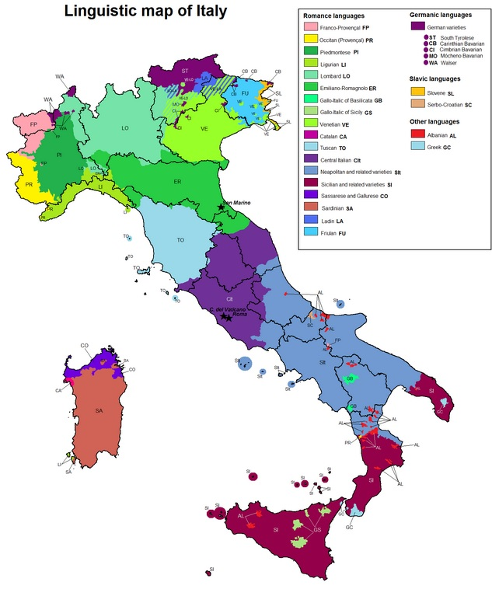
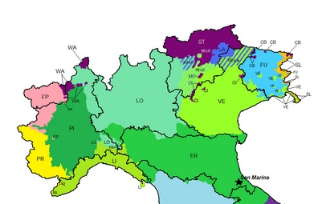
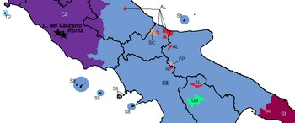
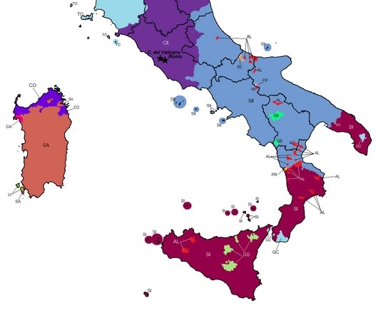
Color guide
Northern Italian dialects (NIDs)
Upper Southern Italian dialects (U/SIDs)
Central and southern Italian
3

Slide 4
Strong Minimalist Thesis
Strong Minimalist Thesis
“Language is an optimal solution to legibility conditions”[Chomsky 2000: 96]
The output of narrow syntactic operations must be readable/fully interpretable at the interface with PF and LF
How do we ensure readability?
How do we deal with apparent exceptions?
4

Slide 5
Minimalist method
Minimalist “method”
Occam’s razor: Postulate only what is conceptually necessary (if we are not sure something is really there, we are not allowed to postulate it)
Inclusiveness condition
No new features are introduced by CHL [Chomsky 2000: 113]
Eliminate from Narrow Syntax everything that is not readable at the interface (see Agree and valuation/deletion)
5

Slide 6
Strong Minimalist Thesis
Reversing the point of view
Readability
“We propose that the answer is that PF instructs syntax on FI conditions for any expression π that syntax will produce. Therefore, phonologically relevant chunks can and must be reflected in syntax.” [D’Alessandro & Scheer forth.]
6

Slide 7
Strong Minimalist Thesis
PF and LF instruct syntax
Exceptions are not (always)
such
“Exceptions” can help us understand what’s in and
what’s out Narrow Syntax
Clitics
Subject-oriented auxiliaries
Vocatives
7

Slide 8
Narrow syntax. What’s in: Clitics
Clitics are a problem for legibility conditions
“[…]T, C, D, and Agr. The first three have Interpretable features providing "instructions" at either or both interface levels. Agr does not; it consists of -Interpretable formal features only. We therefore have fairly direct evidence from interface relations about T, C, and D, but not Agr. Unlike the other functional categories, Agr is present only for theory-internal reasons.” [Chomsky 1995:349]
8

Slide 9
Clitics
clitics
Heads encoding exclusively uninterpretable φ-features have no right to exist. Eliminate from NS!
Subject clitics/clitic doubling
(1) La Maria la magna [Venetan]
the Mary-sg.f SCL-3.sg.f eats-3.sg
“Mary eats”
(2) la drom-la? [Oviglio, Piedmont]
SCL-3.sg.f sleeps SCL-3.sg.f
“Does she sleep?” (Manzini & Savoia 2007:36)
(3) Lo empujaron a Juan. [Spanish]
CL-3.sg.m=pushed to John
“They pushed John” (Torrego 1994:199)
9

Slide 10
Clitics
clitics
SCLs and doubling clitics do not convey (extra) semantic information
NID subject clitics are not pronominal
Rizzi (1986): NID SCLs are inflectional features.
Evidence:
agreement markers may follow preverbal negation, but not pronouns
agreement markers are compatible with negatively quantified subjects, but not pronouns (left dislocation of neg Q: *noone, he left)
agreement markers must appear in both conjuncts of a coordinate structure, pronouns must not
agreement paradigms may contain gaps; pronoun paradigms do not.
10

Slide 11
Clitics
clitics
Trigger for cliticization? Agree [Roberts 2010]
What is the trigger for cliticization? […] This is nothing other than Agree.
Agree plus spell-out of features on the probe: cliticization
(4) a. Trigger for Agree
v* [Pers: ___, Num: ___] D [Pers: a, Num:b], [Case: __]
b. Outcome of Agree D [Pers: a, Num:b], [Case: __]
v* [Pers: a, Num: b]
Roberts (2010:59)
Roberts’s proposal ok for argumental clitics. Problems with doubling/tripling.
11

Slide 12
Person-oriented auxiliaries
auxiliaries
Upper southern auxiliary selection patterns
(5)
a. (ji)So magnatə be (I) am eaten.sg ‘I have eaten’ | d.(nu) seme magnitə be we are eaten.pl ‘We have eaten’
b.(tu) si magnatə be you are eaten.sg ‘You have eaten’ | e. vu sete magnitə be you.pl are eaten.pl ‘You have eaten’
c.(essə) a magnatə have (s)he has eaten.sg ‘(he) has eaten’ | f.(jissə)a magnitə have they have eaten.pl ‘They have eaten’
[D’Alessandro & Roberts 2010]
12

Slide 13
Person-oriented auxiliaries
auxiliaries
What are they? What is their function?
They double the subject info
(6)
a. [pers] [pers, nr] b. [pers, nr]
So = s (BE=1/2) + -o (1.sg) faccə = f (‘do’) + accə (1.sg)
si = s (BE =1/2) + - i (2.sg) fi = f (‘do’) + -i (2.sg)
a = a (HAVE =3) + a (3) fa = f (‘do’) + -a (3)
semə = s (BE =1/2) +-emə(1.pl) facemə = fac (‘do’) + -emə(1.pl)
setə = s (BE =1/2) + -etə (2.pl) facetə = fac (‘do’) + -etə (2.pl)
a = a (HAVE =3) + a (3) fa = f (‘do’) + - a (3)
D’Alessandro & Ledgeway (2010)
13

Slide 14
What if?
clitics
auxiliaries
(7)
(8)
A (1/2) dormja [Semione] So = s (BE=1/2) + -o (1.sg)
Ty (2.sg) dorm si = s (BE =1/2) + - i (2.sg)
U/la (3.sg) dorm a = a (HAVE =3) + a (3)
A (1/2) dormon semə = s (BE =1/2) + -emə (1.pl)
A (1/2) durmit setə = s (BE =1/2) + -etə (2.pl)
I (3.pl) dorm a = a (HAVE =3) + a (3)
[M&S 2005:72]
14

Slide 15
Then
clitics
auxiliaries
We would have a double problem (with postulating φ heads)!
(But auxiliaries are roots! Yes, but…wait)
15

Slide 16
Condition on the Merger of φ heads
(9) Condition on the Merger of φ heads
A purely φ-head π, i.e. a head encoding only unvalued, uninterpretable φ-features, can be merged into the syntactic spine; for the derivation to converge, π must be incorporated into/merged with a semantically non-empty head before the interface with the CI system is reached.
16

Slide 17
Clitics
SCLs are π heads – they can exist, but they MUST incorporate, cliticize onto T (or v, or C) before Transfer
This implies that they cannot occupy positions on their own in the left periphery (contra Poletto 2000, Manzini & Savoia 2005, 2007, etc.)
The relative order of clitics is a PF phenomenon (problem?)
17

Slide 18
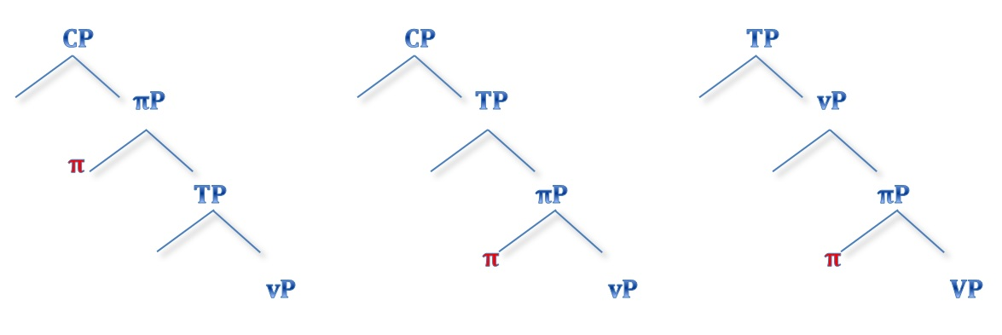
Where is π?
In the v field (“extended” vP)
In the T field (“extended” TP)
In the V field (“extended” VP)
(10)
18

Slide 19
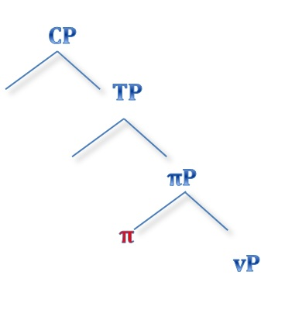
What is π?
clitics
auxiliaries
In the v field (“extended” vP)
Within the vP
SCLs
Auxiliary roots in subject-driven aux selection languages
(11)
19

Slide 20
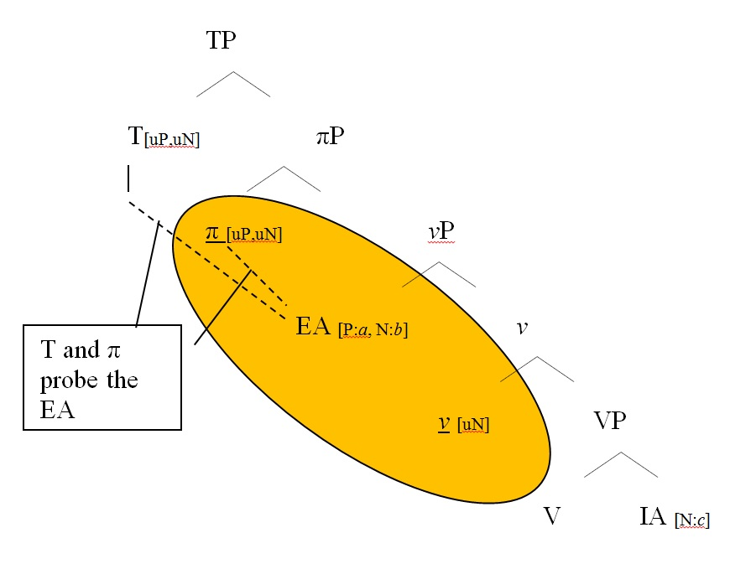
What is π?
π in the v field
uφ
(12)
D’Alessandro (2013:23)
20

Slide 21
What is π?
21

Slide 22
What is π?
Lexicalization of π
22

Slide 23
What is π?
Lexicalization of π
Subject clitics
clitics
23

Slide 24
What is π?
Lexicalization of π
auxiliaries
Person-oriented Auxiliary roots
24

Slide 25
Subject clitics
(13)
π
A (1/2) dormja [Semione]
Ty (2.sg) dorm
U/la (3.sg) dorm
A (1/2) dormon
A (1/2) durmit
I (3.pl) dorm [M&S 2005:72]
(14)
25

Slide 26
Auxiliaries
(15)
π T
So = s (BE=1/2) + -o (1.sg)
si = s (BE =1/2) + - i (2.sg)
a = a (HAVE =3) + a (3)
semə = s (BE =1/2) + -emə (1.pl)
setə = s (BE =1/2) + -etə (2.pl)
a = a (HAVE =3) + a (3)
D’Alessandro (2013)
26

Slide 27
Subject clitics and auxiliaries
There is no such a large variation in aux combination as there is for SCL
There are several types of SCLs (also invariable ones)
False issues
There is as much variation in auxiliaries as there is in SCLs. Virtually all combinations are possible
Invariable SCLs are π in the C field
27

Slide 28
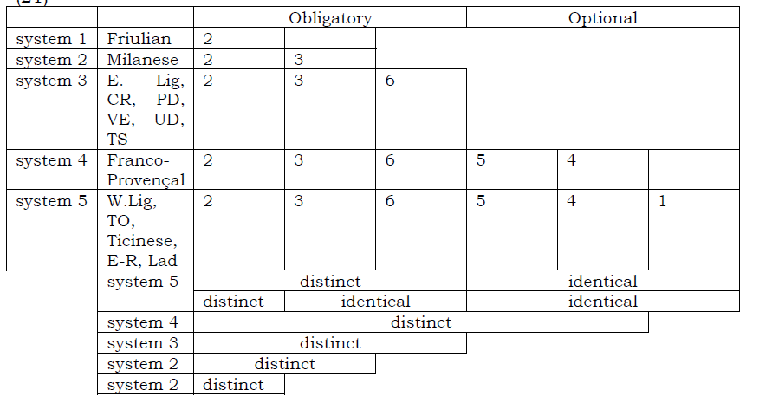
Clitics vs auxiliaries
clitics
auxiliaries
(16)
Renzi & Vanelli (1983) in Ledgeway 2006
(17)
BE only for 2
BE for 2 and 3
BE for 3, 2 and 6
BE for 2,3,6,5,4
BE for 2,3,6,5,4,1
28

Slide 29
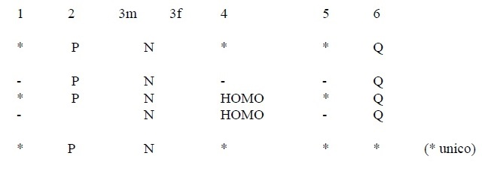
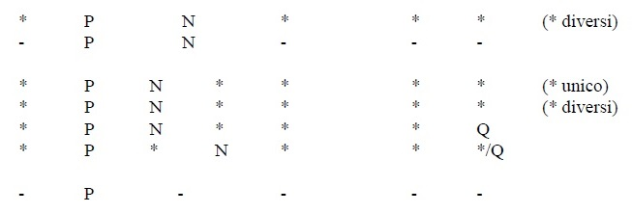
Clitics vs auxiliaries
clitics
(18)
320 pages in M&S!
[Manzini & Savoia 2005:117]
29

Slide 30
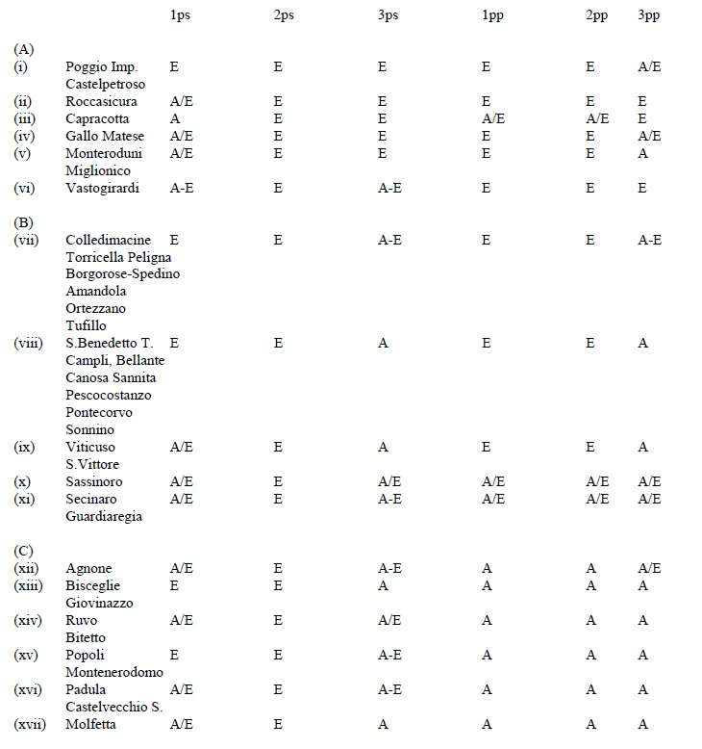
Clitics vs auxiliaries
auxiliaries
(19)
E = BE
A = HAVE
[Manzini & Savoia 2005:728]
30

Slide 31
Auxiliaries
auxiliaries
 | 1 | 2 | 3 | 4 | 5 | 6
Pompei1 | A | E | E | A E | A E | A E
Pompei2 | E | E | E | E | E | E
Pompei3 | A | E | E | A | A | A
Pompei4 | A | E | A | A | A | A
Pompei5 | A | A | E | A | A | A
Pompei6 | A | A | A | A | A | A
 | 1 | 2 | 3 | 4 | 5 | 6
P4/5 | A | A | A | A | A | A
P1/2 | E | E | E | A | A | A
P3/6 | E | E | E | E | E | E
P3/6 | A | A | A | A | A | A
(20)
(21)
Rimané (to stay)
Nasce/murì (to be born, to die)
(Cennamo 2001: 434-435)
31

Slide 32
Auxiliaries
auxiliaries
 | 1 | 2 | 3 | 4 | 5 | 6
Sorrento1 | A | E | E | E | E | A
Sorrento2 | A | A | E/A* | A | A | A
Sorrento3 | E | E | E | E | E | E
Sorrento4 | A E | E | E | E | E | E
Sorrento5 | A | E | E | A | A | A
Sorrento6 | A E | E | E | E | E | E A
Sorrento7 | A | A | A | A | A | A
Sorrento8 | A | A | E | A | A | A
(22)
Nasce, murì (to be born, to die)
Cennamo (2001: 436), see also Torcolacci (2014a,b,c)
Nasce/murì (to be born, to die)
32

Slide 33
Interim conclusions
Lexicalisation is what it is: lexicon
Which clitic is codified depends on the language
Which form is BE and which is HAVE depends on the language
Borer-Chomsky conjecture: All parameters of variation are attributable to differences in the features of particular items (e.g., the functional heads) in the lexicon. [Baker 2008]
BE/HAVE in these languages are π
Leave the languages free to decide how to express π!
33

Slide 34
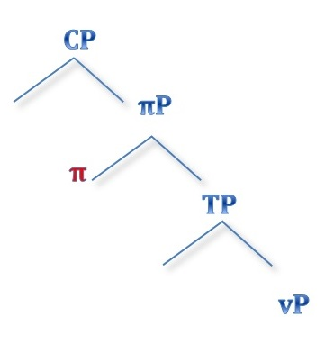
Invariable clitics
Invariable clitics are located in the CP field (Poletto 2000)
They might be topic markers/focus markers
Not an issue: not doubling the subject, not probing it
But: they are π in the left periphery
34

Slide 35
Issues
Auxiliary selection is parasitic on specific tenses (and sometimes verb classes) SCLs are not
Real issue
One possible hint: SCLs change their shape in wh- inversion contexts
35

Slide 36
Narrow syntax. What’s out : the left periphery
Observation: arguments are not prosodically encoded/expressed
Prosody “expresses” the left periphery
PF informs syntax: prosody only reads the left periphery
Prosody needs segmental material to be expressed
φ-features are for phonology; “edge”/discourse features are for prosody
36

Slide 37
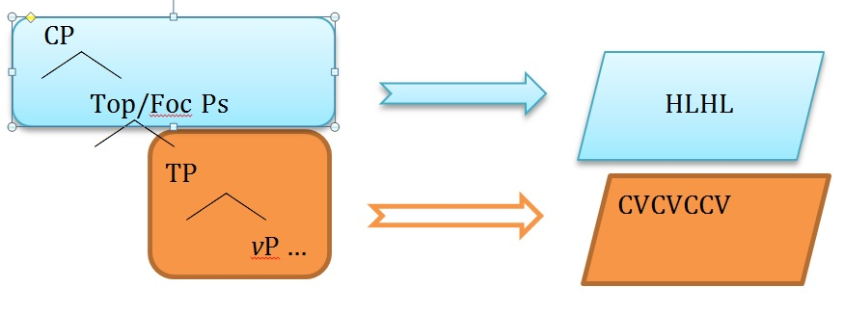
What’s out : the left periphery
The syntactic tree is built the way we know by conceptual necessity
First argument structure, then discourse
First phonological segments, the prosody
(23)
[D’Alessandro & Van Oostendorp 2013, 2014]
37

Slide 38
Vocatives
vocatives
Central and southern Italian dialects,
Sardinian Catalan, Corsican,
Sardinian (Alber 2010, Vanrell & Cabré 2011):
(24) Mari’ [Maria]
(25) Mariacarme’ [Mariacarmela]
(26) Andreadalpo’ [Andrea dal Pozzo]
Truncation, but not to a prosodic constituent.
38

Slide 39
Vocatives
vocatives
Vocatives are often
expressed prosodically
Other vocatives by truncation: Yapese, Central Yupik, Indonesian, Algherese Catalan
True vocatives (deictic, calling) (Espinal 2011)
(Kuen 1932, Jensen 1977, D’Hulst, Coene, & Tasmowski 2007, Hill 2007, Cabré & Prieto 2008, Heinz 2008, Göksel & Pöchtrager 2010, Schaden 2010…)
39

Slide 40
Vocatives
vocatives
What we know:
Vocative is not structural
Case (Moro 2004)
True vocatives (deictic, calling) vs fake vocatives (Espinal 2011)
The VocP is somewhere in the left periphery, possibly above Force
40

Slide 41
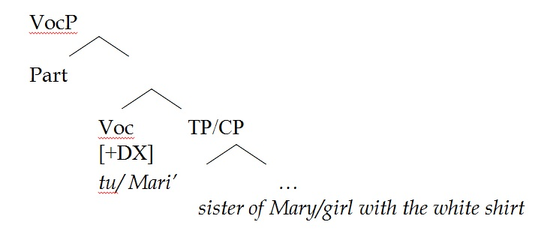
Vocatives
vocatives
(27)
41

Slide 42
Vocatives
vocatives
(27)
Prosody
42

Slide 43
Vocatives
vocatives
(28)
Göksel & Pöchtrager (2010)
43

Slide 44
Vocatives
vocatives
The exponent of the vocative is (at least) a pitch accent, which is specified for being at the same time a boundary tone (i.e. T*%).
Pitch accent makes it want to be on the stressed syllable.
Boundary tone makes it want to be at the edge of the constituent.
44

Slide 45
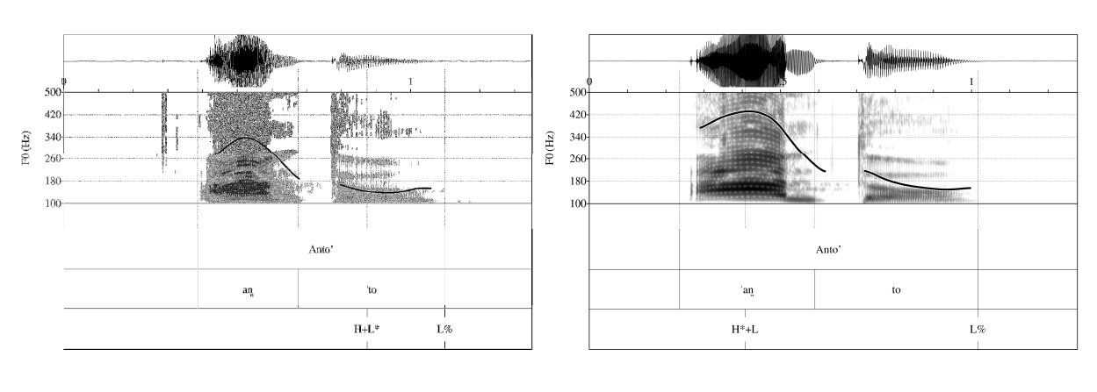
Vocatives
vocatives
Pitch accent makes it want to be on the stressed syllable.
Boundary tone makes it want to be at the edge of the constituent.
(29)
Vanrell & Cabré (2011)
45

Slide 46
Vocatives
vocatives
Pitch accent makes it want to be on the stressed syllable.
Boundary tone makes it want to be at the edge of the constituent.
CONFLICTING REQUIREMENTS!
The paradox is resolved by making the stressed vowel be exactly on the edge of the constituent – i.e. by truncation of everything following it.
[D’Alessandro & Van Oostendorp 2013,2014]
46

Slide 47
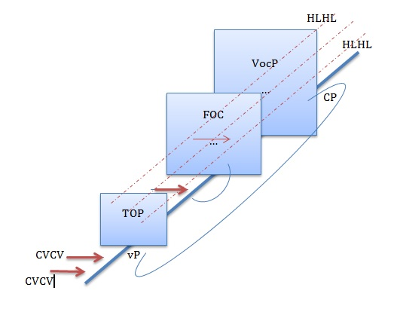
Grammar
(30)
47

Slide 48
Grammar
(30)
vocatives
auxiliaries
clitics
48

Slide 49
Grazjə a ssəgnurì!
49

Slide 50
Selected references
Alber, Birgit. 2010. An Exploration of Truncation in Italian. In Working Papers in Linguistics vol. 3: 1-30, ed. P. Staroverov, D. Altshuler, A. Braver, C. Fasola, and S. Murray. New Brunswick, NJ: LGSA.
Cennamo, Michela. 2001. L’inaccusatività in alcune varietà campane. Teoria e dati a confronto. Atti del XXXIII convegno SLI, 419-444.
Chomsky, Noam. 1995. The Minimalist Program. MIT Press.
Chomsky, Noam. 2000. ‘Minimalist inquiries: The framework’. In Step by Step. Essays on Minimalist Syntax in Honor of Howard Lasnik, R. Martin et al (eds.), 89–155. Cambridge MA: The MIT Press. D’Alessandro & Scheer (forth.)
D’Alessandro, Roberta. 2013. Merging Probes. Ms, Leiden University.
Vocatives in Southern Italian and the syntax-prosody interface. Ms, Leiden University and Meertens Instituut.
D’Alessandro, Roberta & Marc Van Oostendorp. 2013. A two-plane model for language architecture. Ms, Leiden University and Meertens Instituut.
D’Alessandro, Roberta and Adam Ledgeway. 2010. The Abruzzese T-v system: feature spreading and the double auxiliary construction. In Syntactic variation. The dialects of Italy, eds Roberta D’Alessandro, Adam Ledgeway and Ian Roberts, 201-209. Cambridge: Cambridge University Press.
D’Alessandro, Roberta & Ian Roberts. 2010. Past participle agreement in Abruzzese: split auxiliary selection and the null-subject parameter. Natural Language and Linguistics Theory 28: 41-72.
D’Alessandro, Roberta & T. Scheer. (forth.) Modular PIC. Linguistic Inquiry.
50

Slide 51
Selected references (cont’d)
Manzini, Rita & Leonardo Savoia. 2005. I dialetti italiani e romanci. Alessandria: Edizioni dell’Orso.
Manzini, Rita & Leonardo Savoia. 2007. M. R., and Savoia, L. M. (2007). A Unification of Morphology and Syntax. Studies in Romance and Albanian Dialects. London: Routledge.
Poletto, Cecilia. 2000. The higher functional field. Oxford University Press.
Renzi, Lorenzo and Laura Vanelli. 1983. I pronomi soggetto in alcune varietà romanze. In Scritti
linguistici in onore di Giovan Battista Pellegrini. Pisa: Pacini. 121-145.
Rizzi, Luigi. 1986. On the Status of Subject Clitics in Romance", in Studies in Romance Linguistics, O. Jaeggli and C. Silva Corvalan, eds., Foris Publications, Dordrecht.
Roberts, Ian. 2010. Agreement and Head Movement. Linguistic Inquiry Monograph 59. Cambridge, Mass: MIT Press.
Torcolacci, Giuseppe. 2014a. The m-marking of φ. Evidence from perfective auxiliaries in Southern Italian dialects. Proceedings of LSRL44, University of London, ON.
Torcolacci, Giuseppe. 2014b. Il Raddoppiamento Fonosintattico e la codifica di tratti morfosintattici. Il caso dei dialetti italiani meridionali’. L’Italia Dialettale 75.
Torcolacci, Giuseppe. 2014c. Sulla natura degli ausiliari perfettivi di terza persona nelle varietà italo-romanze meridionali. Proceedings of CILPR27, University of Nancy.
Vanrell, Maria del Mar & Teresa Cabré. 2011. , Troncamento e intonazione dei vocativi in Italia centromeridionale, in Contesto comunicativo e variabilità nella produzione e percezione della lingua, Atti del 7 convegno AISV (26-28 gennaio 2011, Lecce) (B. Gili-Fivela, A. Stella, L. Garrapa & M. Grimaldi, editors), Roma: Bulzoni.
51

