Slide 1
The achievements of Generative Grammar A time chart (and some considerations)
Roberta D’Alessandro
UiL OTS Utrecht & CLT UAB
Generative Syntax 2017
Barcelona, 21-23 June 2017

Slide 2
The achievements of generative grammar
Roberta D’Alessandro
Barcelona, 21 June 2017
Introduction
What have we achieved?
What can still be achieved and how?
Does it make sense to keep working on the analysis of language phenomena?
Triggers
Ángel and Dennis’s invitation
Facebook inquiry about “discoveries”
Athens workshop Generative Syntax in the Twenty-First Century: The Road Ahead.

Slide 3
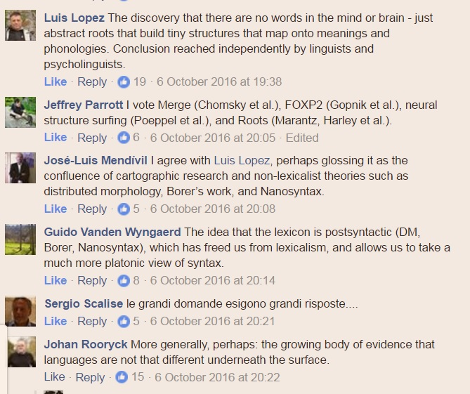
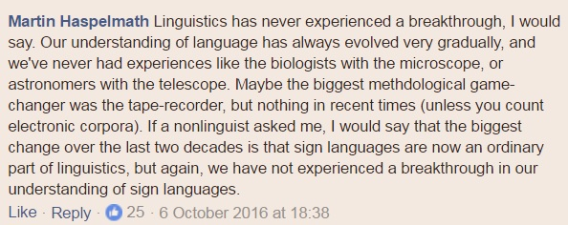
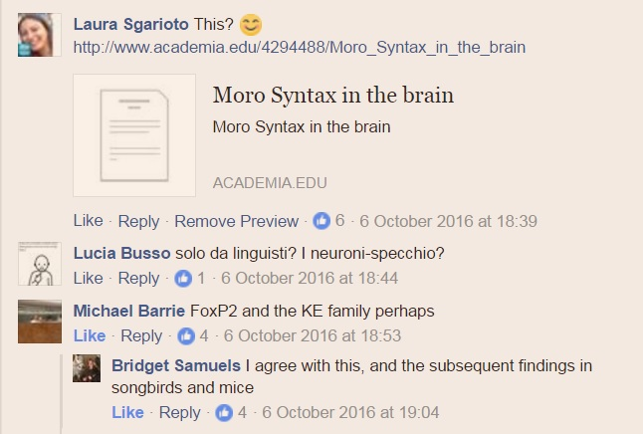
Facebook query
Roberta D’Alessandro
Barcelona, 21 June 2017

Slide 4
Achievements/results: different definitions
Roberta D’Alessandro
Barcelona, 21 June 2017
Generalizations on languages which wouldn’t be otherwise possible
«Laws» of Grammar (generalizations on grammars)
Experimental proof of what we think we know from observation

Slide 5
Achievements of Generative Grammar
Roberta D’Alessandro
Barcelona, 21 June 2017
Generative Syntax in the Twenty-First Century: The Road Ahead
Athens, 2015
Peter Svenonius blogged a list, compiled by Mark Baker, Rose-Marie Déchaine, Amy Rose Deal, Winfried Lechner, Julie Legate, Ian Roberts, Ivy Sichel, and Peter Svenonius himself
Checking the dates

Slide 6
The list
Roberta D’Alessandro
Barcelona, 21 June 2017
The original list concerns mid-level-coverage results in generative grammar (or rather: syntax) for which there is a broad consensus.
According to Gillian Ramchand’s blog, “ ‘mid level generalizations’ […] refer to the concrete results of bread and butter generative syntax (whether GB, LFG or HPSG) which would not have been discovered without the explicit goals and methodologies of generative grammar (MLGs)”.

Slide 7
Mid-level coverage results in generative grammar
Roberta D’Alessandro
Barcelona, 21 June 2017
Unaccusativity [There are two classes of monovalent verbs such that the argument in the unaccusative class is predicate-internal, while the argument in the unergative class is predicate-external (in derivational terms, the unaccusative argument originates predicate-internally)]: Hall (1965)
The Agent asymmetry [NPs bearing Agent roles are higher than NPs bearing other roles in the unmarked structure of the clause]: Keenan & Comrie (1972)
Passive valence reduction: [Agents are the easiest arguments to suppress in valency reduction]: Keenan (1975)

Slide 8
X-bar theory, categories, and headedness
Roberta D’Alessandro
Barcelona, 21 June 2017

Slide 9
X-bar theory, categories, and headedness/2
Roberta D’Alessandro
Barcelona, 21 June 2017

Slide 10
Movement in general (not restricted to A-bar or A)
Roberta D’Alessandro
Barcelona, 21 June 2017
Coordinate Structure Constraint: Ross (1967)
Head Movement Constraint: Travis (1984)
Movement is upward: Ross (1967)
Right Roof constraint: Ross (1967)
Second position: Kayne (1994)
Syntactic clitic placement: Steele (1977)

Slide 11
Binding Theory
Roberta D’Alessandro
Barcelona, 21 June 2017
Principle B: Chomsky (1973)/Lasnik (1976)/Chomsky (1981)
Principle C: Chomsky (1973)/Lasnik (1976)/Chomsky (1981)
Structure relevant to binding: Langaker (1966)
Strong crossover: Postal (1971)/Wasow (1972)
Weak crossover: Postal (1971)/Wasow (1972)

Slide 12
Arguments
Roberta D’Alessandro
Barcelona, 21 June 2017
Improper movement: Chomsky (1977)?
Control versus raising: Rosenbaum (1965)
Structural agreement: Aissen (1989)
Grammatical Subject: Chomsky (1965)
Diesing’s Generalization: Diesing (1992)
Person-Case Constraint (PCC): Perlmutter (1971)
No NCC: Nevins (2011)
Ergative subjects: Mahajan (1997)
Null subjects: Perlmutter (1971)
High causatives: Baker (1988)
Marantz’ Generalization: Marantz (1984)
Erg Agreement is dependent on Erg case (Bobaljik 2008, and typological sources)]: Anderson (1977)
No Active Case (Baker and Bobaljik in press/in progress, but well documented)]: Mithun (1991)?

Slide 13
Quantifier raising
Roberta D’Alessandro
Barcelona, 21 June 2017
QR: Bach (1968), May (1977)
QR is clause bound : May (1985)
Widest scope indefinites: (Fodor & Sag 1982)
Reconstruction : Chomsky (1976)

Slide 14
A-bar. A-bar phenomena
Roberta D’Alessandro
Barcelona, 21 June 2017
A-bar Unity: Chomsky (1977), Chomsky (1981)
Successive Cyclicity: Fillmore (1963)/Chomsky (1973)
Covert A-bar dependencies: Huang (1982)
Subject-object asymmetry for A-bar: Ross (1967)
Freezing: Ross (1967)
Specifier bias in Pied-piping: Ross (1967)?
Adjunct extraction is hard: Huang (1982)
Parasitic gaps: Ross (1967)
Resumptive pronouns: Ross (1967)
Resumptive pronoun island alleviation: Ross (1967)
Local subject condition on resumption: McCloskey (1990)
Left-dislocation: Lambrecht (1994)
Intervention Effects (Beck Effects) Beck (1996)

Slide 15
Time chart
Roberta D’Alessandro
Barcelona, 21 June 2017

Slide 16
Additions
Roberta D’Alessandro
Barcelona, 21 June 2017
Root vs non­-root transformations [Some transformations can only take place in root environments.]: Emonds (1969)
Accessibility hierarchy for relativization [see also the Agent asymmetry above]: Keenan & Comrie (1972)
X-bar theory, categories, and headedness
C-command: Klima (1964)/Reinhart (1976)
COMP/C: Bresnan (1972)
Movement in general (not restricted to A-bar or A)
Remnant movement: Tiersch (1985)
Principle of Minimal Compliance: Richards (1989)
Minimality/Relativized Minimality: Chomsky (1986)/Rizzi (1990)
Clitic doubling voids A-minimality effects: Anagnostopoulou (2003)

Slide 17
Additions/2
Roberta D’Alessandro
Barcelona, 21 June 2017
Arguments
VP-shells: Chomsky (1955)/Larson (1988)
Non-nominative subjects [Non-nominative subjects behave like structural subjects]: Andrews (1976)
Split subject position/two subject positions: Schachter (1976)/Guilfoyle
Exceptional Case Marking: Chomsky (1981)
QR
Quantifier lowering is subject to island constraints: Lakoff (1965)/(1970)
A-bar. A-bar phenomena.
Some kinds of sluicing ameliorates islands: Ross (1969)

Slide 18
Integrated time chart
Roberta D’Alessandro
Barcelona, 21 June 2017

Slide 19
Issues
Roberta D’Alessandro
Barcelona, 21 June 2017
Decline in findings?
How can we interpret these tables?
GB vs MP/biolinguistics
Outsourcing to other modules
Do we still want to know about languages?
What do languages tell us about UG/FL?
What about the architecture of grammar/modules?

Slide 20
Workshop on Language Universals and Variation
Roberta D’Alessandro
Barcelona, 21 June 2017
The implications of typological evidence for formal grammar
Typologists
Syntacticians
Phonologists
In what follows:
What we can learn from talking to non-generativists
What we can learn from inter-modular communication ☺

Slide 21
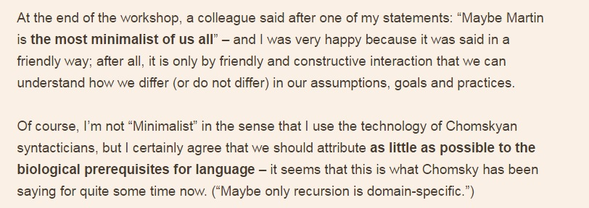
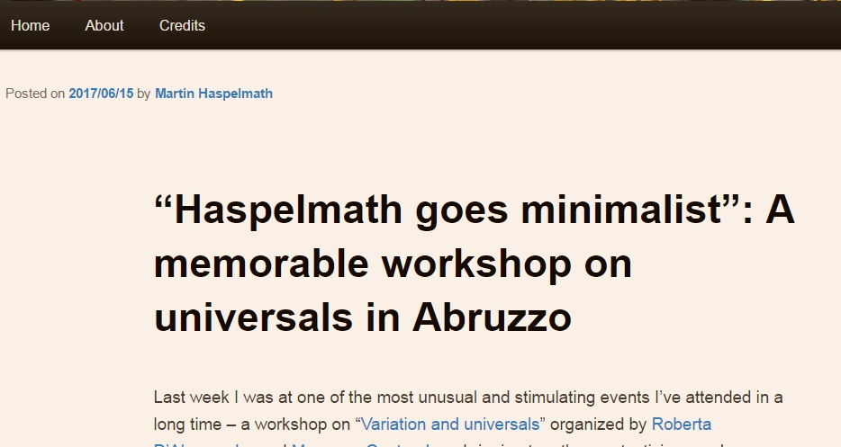
Workshop on Language Universals and Variation
Roberta D’Alessandro
Barcelona, 21 June 2017
Most interesting findings
Typologists and generativists can talk to each other (in fact, Martin Haspelmath turned out to be a core minimalist)
Generative models of grammar accounting for variation / from NS and from PF we get to the same ideas

Slide 22
Coetzee (2017)/Crecchio workshop
Roberta D’Alessandro
Barcelona, 21 June 2017
Coetzee (2017:12)

Slide 23
Coetzee (2017) Crecchio workshop
Roberta D’Alessandro
Barcelona, 21 June 2017
Coetzee (2017:13)

Slide 24
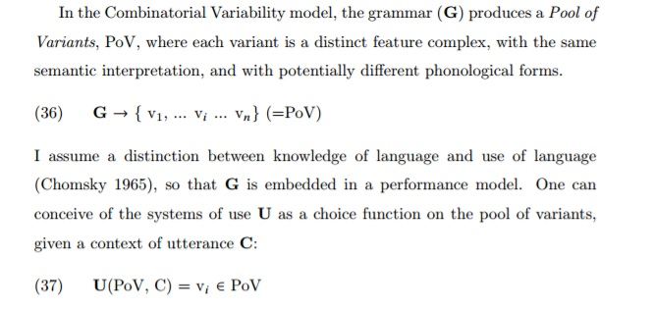
Coetzee (2006, 2017) AND Adger (2015)
Roberta D’Alessandro
Barcelona, 21 June 2017
(Adger 2015:14)

Slide 25
Let’s talk to each other!
Roberta D’Alessandro
Barcelona, 21 June 2017
Observing phonological and syntactic language variation Coetzee and Adger came to the same idea about the architecture of grammar
Inter-modular communication = talking to phonologists and semanticists
D’Alessandro & van Oostendorp (2016)
D’Alessandro & Scheer (2015)

Slide 26
Magnetic grammar
Roberta D’Alessandro
Barcelona, 21 June 2017
Feature strength determines variation
Old idea: strong and weak features
(old idea in SYNTAX – not in Phonology)
Parallel phenomena in SYN and PHON
Model of language variation

Slide 27
Features
Roberta D’Alessandro
Barcelona, 21 June 2017
Features can be combined
They have properties of attraction (⊃) and repulsion (*)
Language 1 | Language 2
F | F
⊃ G | * G
* H
Features come with a specification for interaction (extended BCC)

Slide 28
Attraction
Roberta D’Alessandro
Barcelona, 21 June 2017
Ѫ Syntax : V-movement; wh-movement, agreement
Ѣ Phonology: harmony, assimilation
Verb movement
Romance | V-to-T | T ⊃V
Germanic | V-to-C | C ⊃V
English | no | (T ⊃V)
(we leave pied-piping/free riders etc aside here; features can move alone or pied-pipe their host)

Slide 29
Attraction
Roberta D’Alessandro
Barcelona, 21 June 2017

Slide 30
More syntactic attraction
Roberta D’Alessandro
Barcelona, 21 June 2017
Scrambling
Negative concord
Clitic (doubling)

Slide 31
Attraction in phonology
Roberta D’Alessandro
Barcelona, 21 June 2017
Turkish vowel harmony
Jensen (2004:139)

Slide 32
Turkish vowel harmony
Roberta D’Alessandro
Barcelona, 21 June 2017
Turkish
vocalic ⊃ color, ⊃ front, ⊃ round
low * round
Dutch vocalic color
front round

Slide 33
Static attraction
Roberta D’Alessandro
Barcelona, 21 June 2017
Phonology also provides static evidence for attraction
In some languages the only nasal is /m/
nasal ⊃labial

Slide 34
Repulsion in syntax
Roberta D’Alessandro
Barcelona, 21 June 2017
A feature repels some other feature
In Italian, negation repels imperative
dam-mi la penna
give-me the pen
(2) *non dammi la penna
Non dar-mi la penna
not give.inf-me the pen
Neg * inf

Slide 35
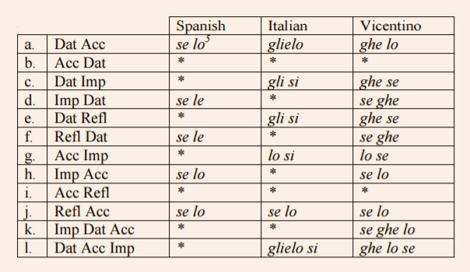
More repulsion in syntax
Roberta D’Alessandro
Barcelona, 21 June 2017
PCC (3 Dat *1,2 acc)
OCP in syntax (*le lo, *si si, *gli lo)
Also some mysterious forbidden clitic clusters can be accounted for in this system, like those found in some Italian dialect
Pescarini (2011: 12)

Slide 36
Repulsion in Phonology
Roberta D’Alessandro
Barcelona, 21 June 2017
Dutch does not have voiced velars
velar *voice
(Van ‘t Veer: acquisional patterns work with features)—
OCP in phonology (Leben 1973)
H*H
(two high tones are not allowed to be adjacent in Chichewa, for instance)

Slide 37
Mapping
Roberta D’Alessandro
Barcelona, 21 June 2017
We look at Transfer from NS (outsourcing to other modules)
What if we look at mapping from PF?
D’Alessandro & Scheer (2015): Modular PIC
The PIC is associated to different heads in different languages
Transfer does not mean opacity (like weak phases in the past)

Slide 38
Modular PIC
Roberta D’Alessandro
Barcelona, 21 June 2017
D’Alessandro & Scheer (2015:602)
Slide 38 of 41

Slide 39
This is all to say...
Roberta D’Alessandro
Barcelona, 21 June 2017
There is a lot to learn from language analysis
Merge is not the only interesting thing to worry about
There is a lot to learn from other subfields
If we come to the same conclusions from different directions...we’re probably right!

Slide 40
Issues
Roberta D’Alessandro
Barcelona, 21 June 2017
Decline in findings?
How can we interpret these tables?
GB vs MP/biolinguistics
Outsourcing to other modules
Do we still want to know about languages?
What do languages tell us about UG/FL?
What about the architecture of grammar/modules?

Slide 41
References
Roberta D’Alessandro
Barcelona, 21 June 2017
Gillian Ramchand’s blog: http://generativelinguist.blogspot.nl/2015/05/athens-day-1.html
Peter Svenonius’s blog:
http://blogg.uit.no/psv000/2016/08/30/significant-mid-level-results-of-generative-linguistics/
Refs for «the list»: in the position paper
Refs for Coetzee’s work: in Coetzee’s position statement https://www.robertadalessandro.it/description
Adger’s model of variation: Adger, D (2016) “Language Variability in Syntactic Theory” L. Eguren, O. Fernández-Soriano and A. Mendikoetxea. (ed) Rethinking Parameters. New York: Oxford University Press. 49-63.
Slide 41 of 41

Slide 42
People who helped with the list
Roberta D’Alessandro
Barcelona, 21 June 2017
Avery Andrews, Tista Bagchi, Theresa Biberauer, Jonathan Bobaljik, Hagit Borer, Stanley Dubinsky, Dan Everett, Berit Gehrke, Alessandra Giorgi, Vera Gribanova, Heidi Harley, Martin Haspelmath, Monica Irimia, Pauline Jacobson, Dalina Kallulli, Alec Marantz, Jason Merchant, Gereon Müller, Francisco Ordoñez, Dennis Ott, Diego Pescarini, David Pesetsky, Omer Preminger, Craig Sailor, Peter Svenonius, Tonjes Veenstra, and Xavier Villalba Nicolas

